Slide 1
Excitation energies, Excited state optimization, Excited state Hessian, Intersystem Crossing, Spin-orbit coupling
Instructor: Prof. Tzuhsiung (Nick) Yang
Email: tyang@mx.nthu.edu.tw
Time: M5/6
Room: NTHU Library Comp Lab II
Notes:
Rafael Gomez

Slide 2
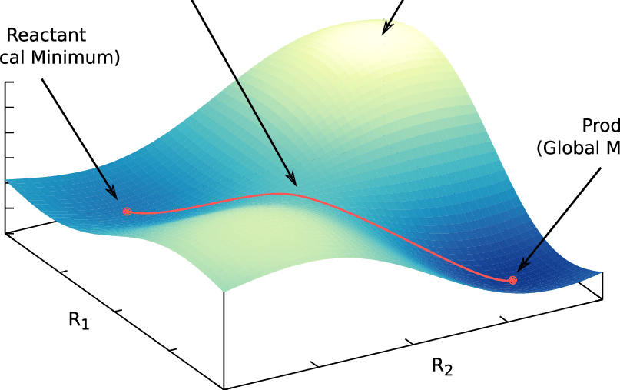
Transition state search
Transition states are first-order saddle points, meaning that they are at the minima of all degrees of freedom except one at which they are at the maximum.
Because of their sparce nature, TS optimization requires good initial guess structures (to minimize energy extrapolation from E₀)
There are multiple methods to locate a good initial guess structure for a TS:
Relaxed surface scan,
Nudged elastic band,

Slide 3
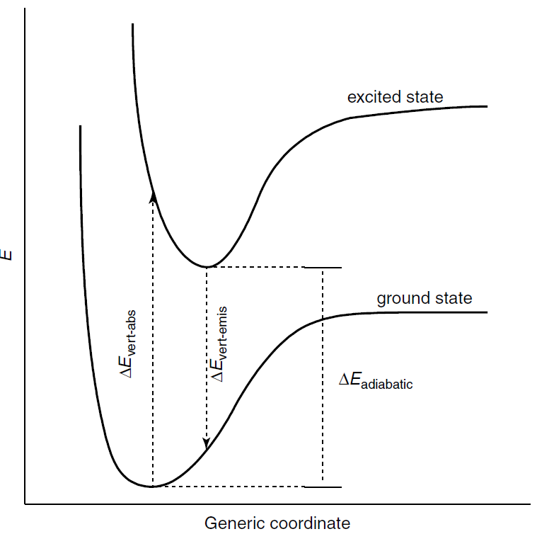
Multiple PESs

Slide 4
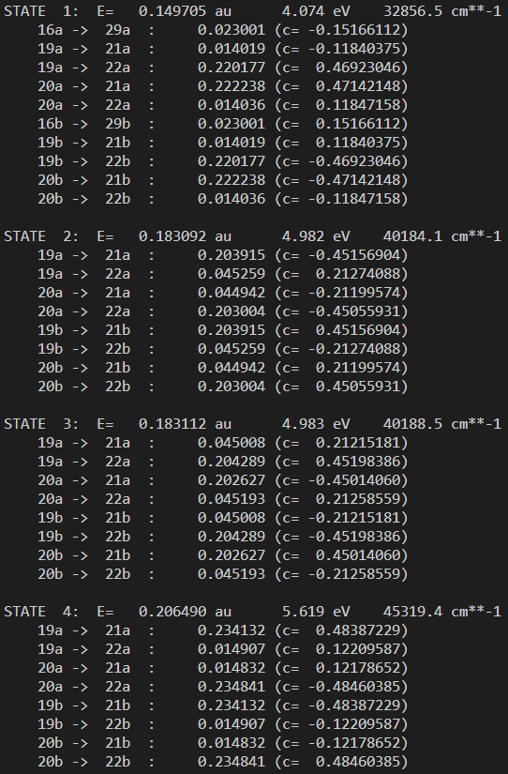
Time-dependent DFT
The output shows that
the excitation energy of each excitations,
Each excited state is described by a linear combination of singlet excited determinant (e.g. 43a -> 44a)
These states are the “poles” to the linear response TDDFT equation, hence, the spectrum will look like a stick plot.

Slide 5
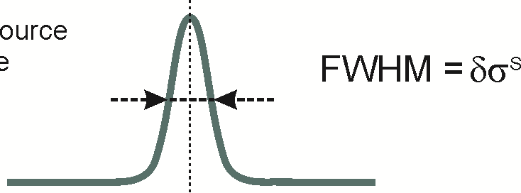
Time-dependent DFT
In the real system, molecules exist in an ensemble according to the Boltzmann distribution. This leads to line broadening.
Therefore, we need to apply line broadening to make a plot that assimilate an experimental spectrum.

Slide 6
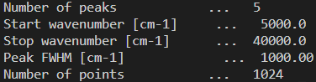
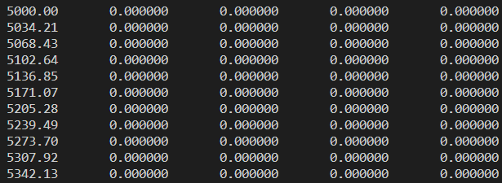
Plot spectrum
The command looks like below:
The printout by the program
-w adjust the FWHM
-n number of points
-x0 specifies energy lower bound
-x1specifies energy upper bound
And the associated output
E(cm⁻¹) T² T_{x} T_{y} T_{z}

Slide 7
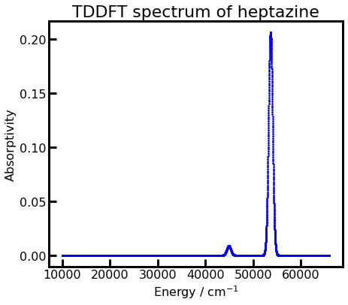
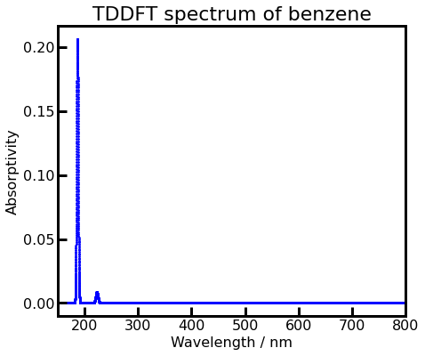
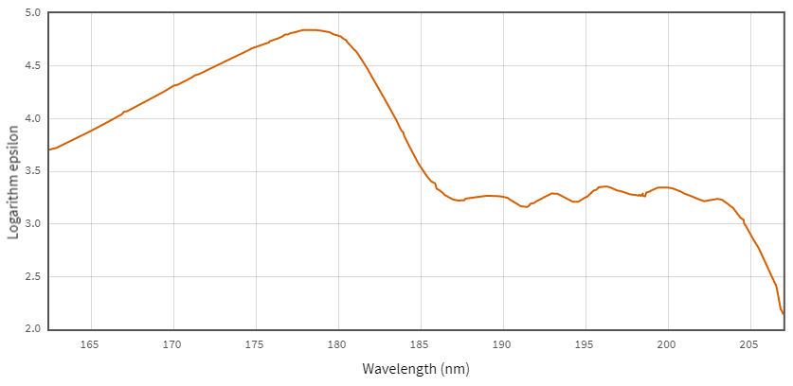
Plot spectrum
Let’s plot the spectrum for -w1000 and –n8192

Slide 8
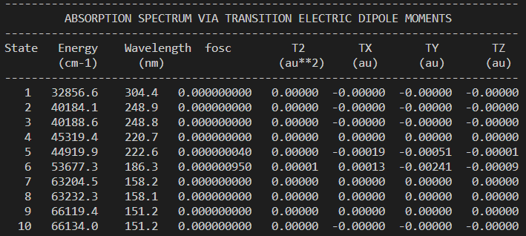
Analyze excitations
The full table of properties of the excitations by electric dipole

Slide 9
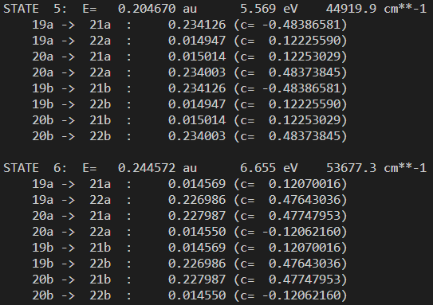
Analyze excitations
The states with high transition probability
We will then plot the donor and acceptor orbitals for state 2

Slide 10

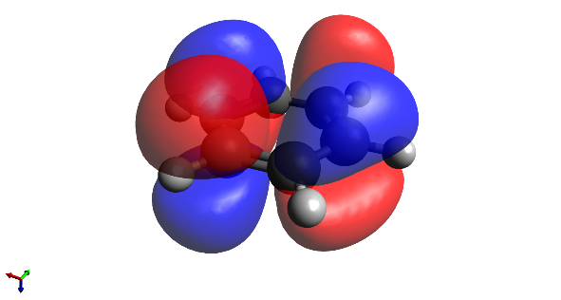
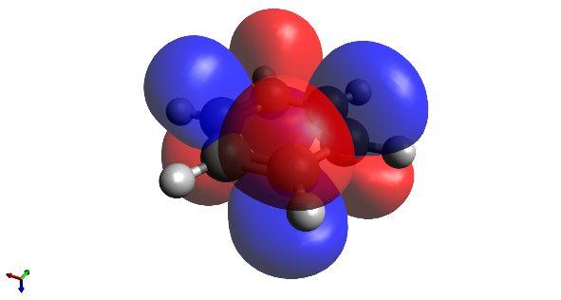
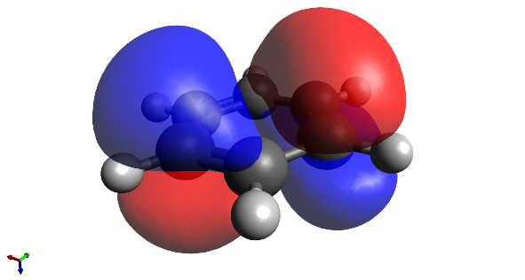
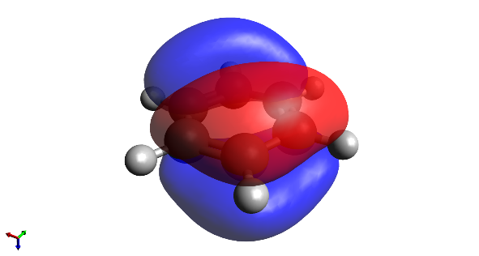
Analyze excitations
Let’s add the donor/acceptor orbitals to the excitations
acceptor
22
21
hν
donor
19
20

Slide 11
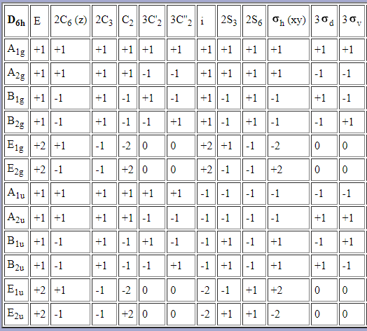
Analyze excitations
Let’s assign the irreducible representations to the orbitals
acceptor
22
e_{2u}
21
e_{2u}
hν
donor
19
e_{1g}
20
e_{1g}

Slide 12
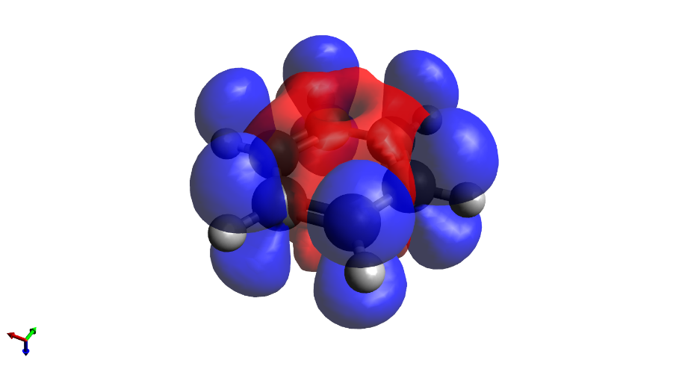
Analyze excitations
Sometimes, it is hard to pick out a specific donor/acceptor set to describe the state (e.g. there are multiple determinants with large weights). It will then be useful to look at the difference density.
acceptor
e_{2u}
e_{2u}
donor
Blue: increase
Red: decrease
e_{1g}
e_{1g}

Slide 13
Interactive

Slide 14
Multiple PESs

Slide 15
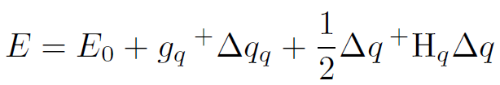
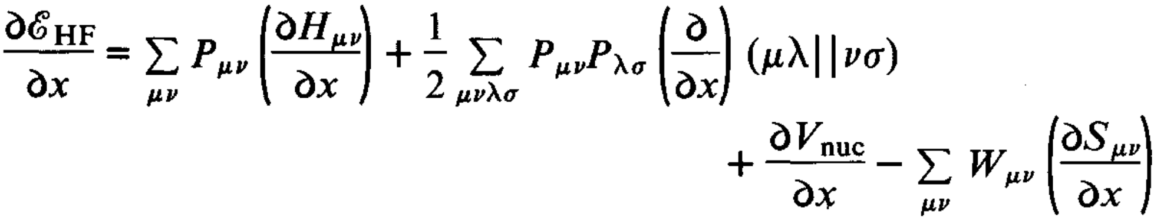
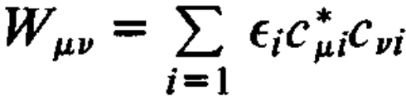
Excited state optimization
Similar, we can optimize the energy of the system, which is a function of nuclear coordinates
Comes from the excited state H, S, G and P
is the energy at the initial coordinate, is the transpose of the nuclear gradient vector, is the step size of update,
is the nuclear Hessian.
The nuclear first derivation of the HF equation is
where is the “energy-weighted density matrix”
Pople, J. A.; Krishnan, R.; Schlegel, H. B.; Binkley, J. S. Derivative Studies in Hartree-Fock and Møller-Plesset Theories. Int. J. Quant. Chem. 1979, 16 (S13), 225–241.

Slide 16
Excited state optimization
SCF
TDDFT
Gradient
Update coordinates
Upon convergence
Optimized

Slide 17
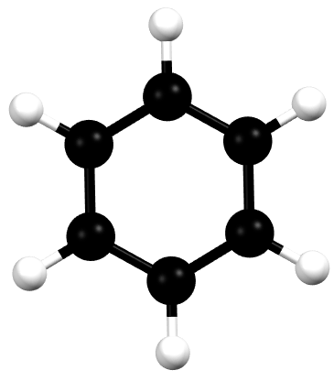
Interactive
 | d(C-C) / Å | d(C-H) / Å
GS
ES
 | d(C-C) / Å | d(C-H) / Å
GS | 1.404 | 1.096
ES | 1.434 | 1.096

Slide 18
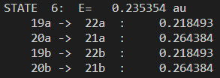
Fluorescence energy
Optimized excited geometry
TDDFT on the optimized geometry
Abs
-Emis
Stoke shift = 2023 cm⁻¹ = 0.25 eV = 7.3 nm

Slide 19
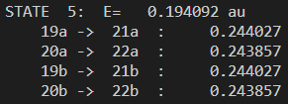
Fluorescence energy
Optimized excited geometry
TDDFT on the optimized geometry
Abs
-Emis
Stoke shift = 2321 cm⁻¹ = 0.29 eV = 12.1 nm

Slide 20
Interactive

Slide 21
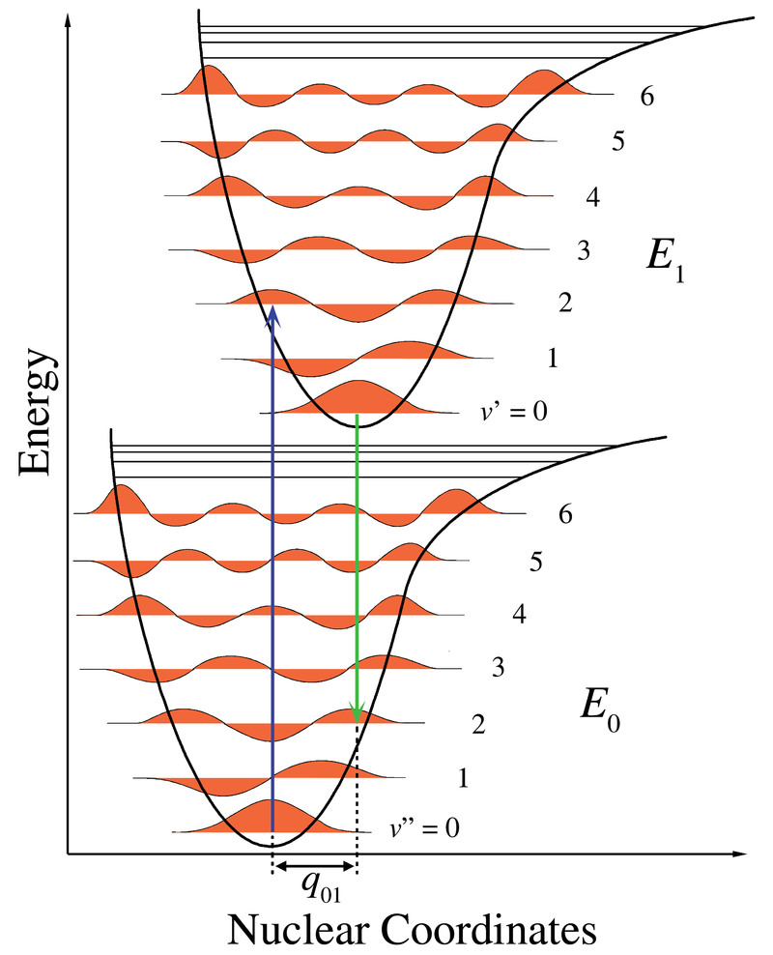
Excited state Hessian
ES Vibrational levels (Hessian)
GS Vibrational levels (Hessian)

Slide 22
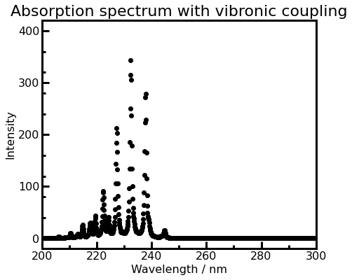
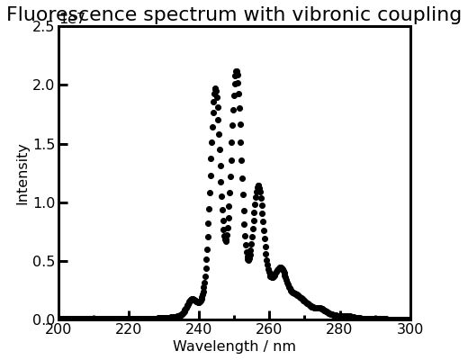
Excited state Hessian
Optimize GS geometry
TDDFT
Optimize ES geometry
GS Hessian
ES Hessian
TDDFT
ESD

Slide 23
Interactive

Slide 24
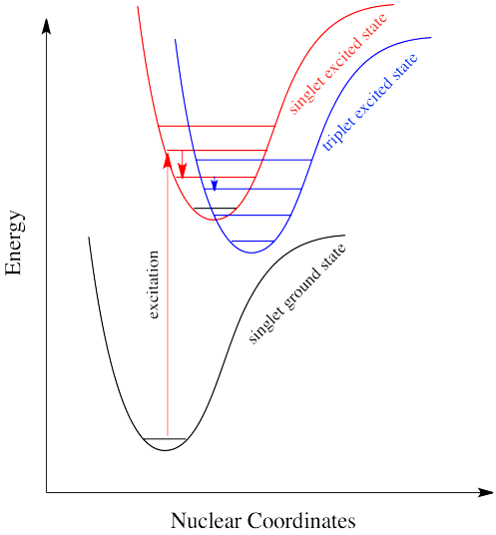
Intersystem crossing

Slide 25
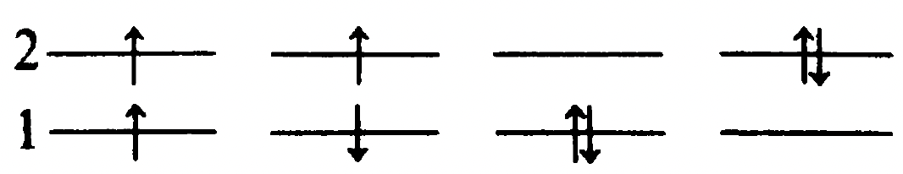
Spin-adapted configurations
(a)
(b)
(c)
(d)
(e)
(f)
The cases (b)-(e) are four singly excited determinants
The open-shell determinants (b) and (c) are eigenfunctions of ${\hat{S}}^{2}$ with eigenvalues of 2 and thus are both triplets:

Slide 26
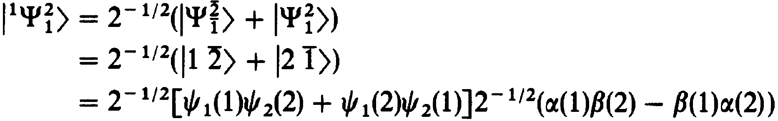
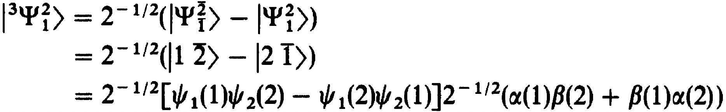
Spin-adapted configurations
(a)
(b)
(c)
(d)
(e)
(f)
For (d) and (e), let’s consider ${\hat{S}}_{−}{\hat{S}}_{+}\left|\left.1\overline{2}\right\rangle \right.$. By chain rule, the first operation will generate${\hat{S}}_{−}\left(0+\left|\left.12\right\rangle \right.\right)$ and the second operation will generate $\left|\left.\overline{1}2\right\rangle \right.+\left|\left.1\overline{2}\right\rangle \right.$. Therefore, the eigenfunction is a linear combination of (d) and (e).

Slide 27
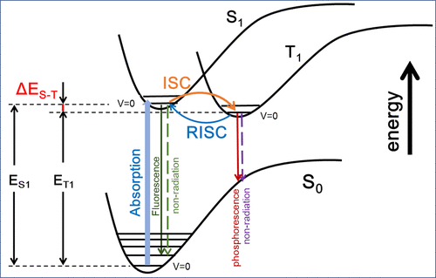
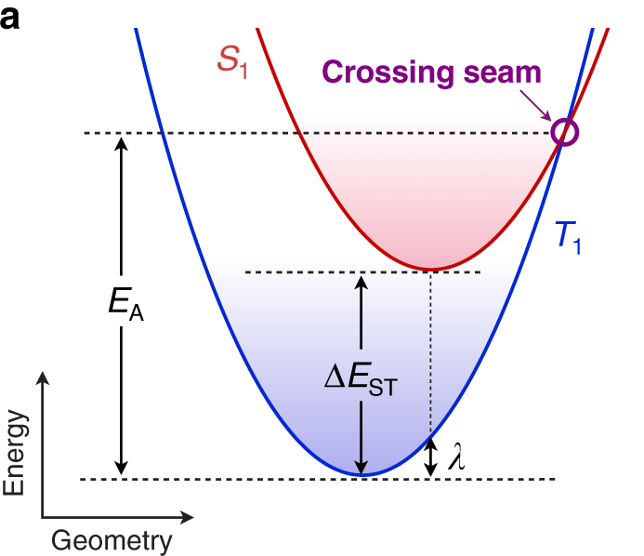
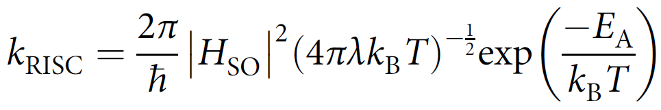
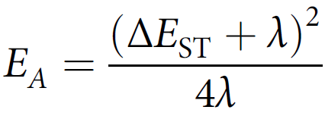
Intersystem crossing
A closer look at the excited states,
The rate of reverse intersystem crossing can be calculated
,

Slide 28
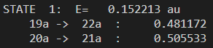
Intersystem crossing
What we had

Slide 29
Interactive
 | d(C-C) / Å | d(C-H) / Å
GS | 1.404 | 1.096
ES | 1.434 | 1.096
³ES
 | d(C-C) / Å | d(C-H) / Å
GS | 1.404 | 1.096
ES | 1.434 | 1.096
³ES | 1.399 | 1.097

Slide 30
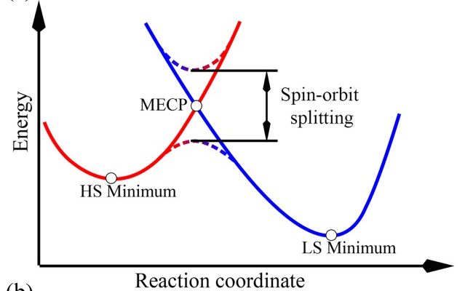
Minimum energy crossing point (MECP)

Slide 31
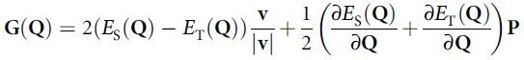
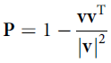
MECP
Similar, we can optimize the energy of the system, which is a function of nuclear coordinates
Comes from the excited state H, S, G and P
is the energy at the initial coordinate, is the transpose of the nuclear gradient vector, is the step size of update,
is the nuclear Hessian.
Now the gradient for optimizing to the MECP is different from the GS. It is as following
,
Pople, J. A.; Krishnan, R.; Schlegel, H. B.; Binkley, J. S. Derivative Studies in Hartree-Fock and Møller-Plesset Theories. Int. J. Quant. Chem. 1979, 16 (S13), 225–241.

Slide 32
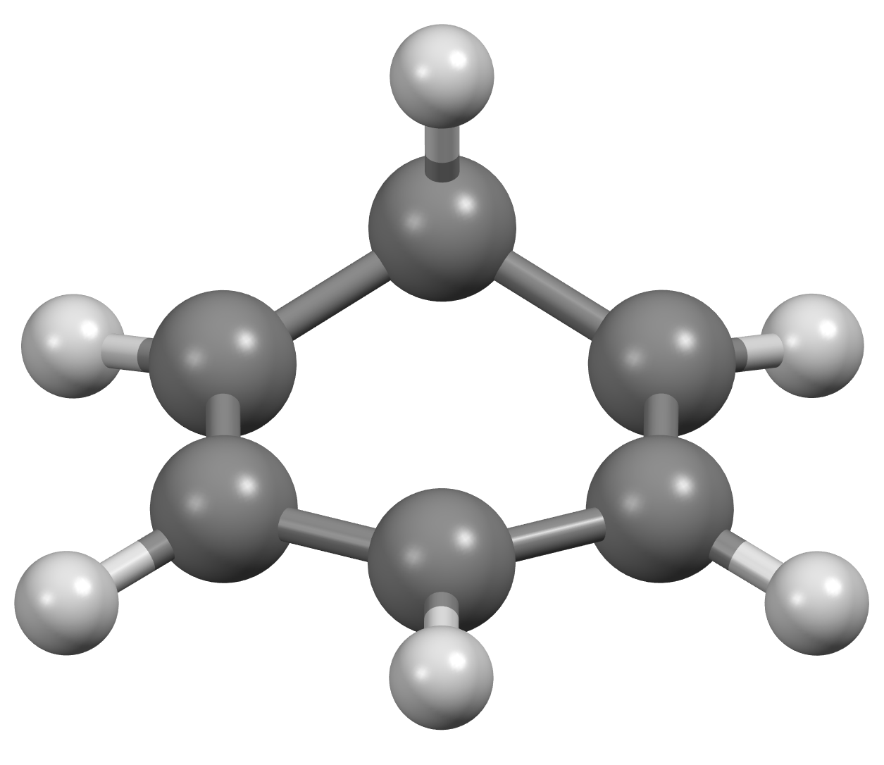
MECP
1.434
1.399

Slide 33
MECP
1.434
1.399

Slide 34
Interactive

